Slide 1


Utilization Of Mine Tailings To Produce Eco-friendly Bricks Through Geopolymerization
21th Annual Arizona Space Grant Consortium Symposium
The University of Arizona, Tucson, Arizona
April 21, 2012
Mark Gregory
Mentor: Dr. Lianyang Zhang
Graduate Students: Saeed Ahmari and Rui Chen

Slide 2
Table of Contents
INTRODUCTION
ECO-FRIENDLY GEOPOLYMER BRICK
EXPERIMENTAL RESULTS
CONCLUSIONS

Slide 3
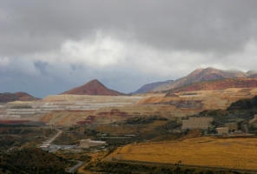
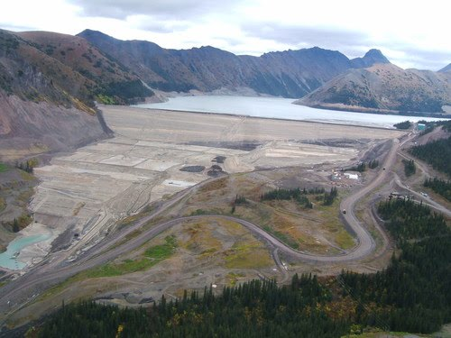
Introduction Storage of Mine Tailings
FreeportMcMoran- The Rod Plant Globe, Arizona (Globe Miami Times, Summer 2008 )
Kemess Mine Tailing Dam in Canada
Tailings are fine grained waste materials that are produced by crushing, screening, or mineral processing operations on mining materials (Drechsler and Graham 2005).

Slide 4
Challenges in Storing Mine Tailings
Large areas of land is required
Tailing dams are susceptible to failure
Costly construction and maintenance
Blowing wind causes dust generation
Mine tailings contain heavy metals and sulfides, which may generate acid mine drainage and contaminate underground water
→A good way to address these problems is to stabilize MT and use them as construction material

Slide 5
Typical Mine Tailing Brick
Feasibility studies have shown that copper mine tailing are an excellent material for brick
Ordinary Portland cement (OPC) is used as binder
750ºC plus kiln firing

Slide 6
Disadvantages of OPC-Based Stabilization
Poor immobilization of the contaminants
Low acid resistance
Disadvantages related to production of OPC
High energy usage and raw material consumption
Greenhouse gases emission

Slide 7
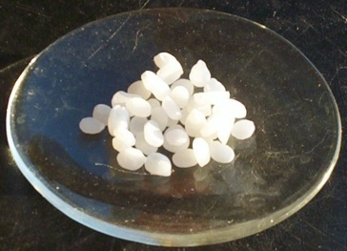
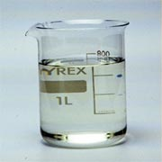
Geopolymerization Definition
Geopolymerization is the process of obtaining a polymeric structure from aluminate and silicate containing material. This is achieved by dissolving the solid material into an alkaline (mostly NaOH/Na₂SiO₄) solution (Deventer et al. 2006).
Mine Tailings
Alkaline (NAOH)
Water
Geopolymer Paste

Slide 8
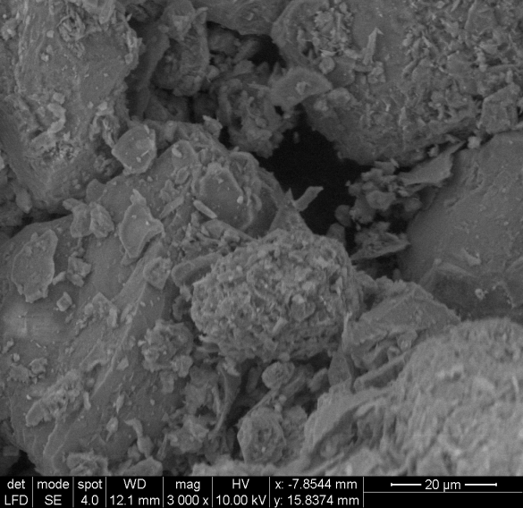
Chemical composition of mine tailings acquired from Mission Mine Operation of ASARCO LLC in Tucson, AZ
Chemical compound | Weight %
SiO₂ | 64.8
Al₂O₃ | 7.08
Fe₂O₃ | 4.33
CaO | 7.52
MgO | 4.06
K₂O | 3.26
SO₃ | 1.66
Na₂O | 0.90

Slide 9
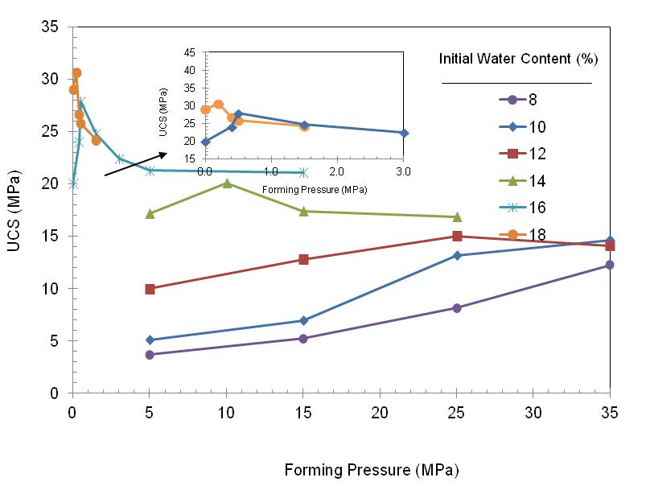
Strength test results
UCS vs. forming pressure, 15 M NaOH and cured at 90ºC for 7 days

Slide 10
ASTM strength specifications
Title of specification | ASTM Designation | Type/Grade | Minimum UCS (MPa) | Maximum water absorption (%) | Abrasion Index
Structural clay load bearing wall tile | C34-03 | LBX | 9.6 | 16 | NA
 |  | LBX | 4.8 | 16 | NA
 |  | LB | 6.8 | 25 | NA
 |  | LB | 4.8 | 25 | NA
Building brick | C62-10 | SW | 20.7 | 17 | NA
 |  | MW | 17.2 | 22 | NA
 |  | NW | 10.3 | No limit | NA
Solid masonry unit | C126-99 | Vertical coring | 20.7 | NA | NA
 |  | Horizontal coring | 13.8 | NA | NA
Facing brick | C216-07a | SW | 20.7 | 17 | NA
 |  | MW | 17.2 | 22 | NA
Pedestrian and light traffic paving brick | C902-07 | SX | 55.2 | 8 | Type I | 0.11
 |  | MX | 20.7 | 14 | Type II | 0.25
 |  | NX | 20.7 | No limit | Type III | 0.50

Slide 11
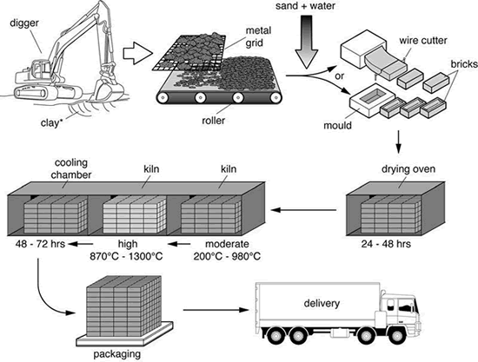
Eco-Friendly Brick Process
Mixing with alkaline solution
1
Extrusion
2
Curing in oven at
90 °C
Packaging
3
4
Delivery

Slide 12


Conclusion
Geopolymerization is a relatively new technique that can be applied to recycle industrial wastes such as mine tailings
Eco- friendly bricks reduces the need for natural resources and greenhouse gases
The produced eco-friendly bricks exceed ASTM requirements for most of the designated applications

